Slide 1

Dr. Sajid Iqbal
Department of Computer Science
Bahauddin Zakariya University, Multan

Slide 2
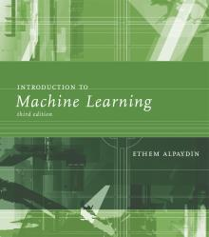
INTRODUCTION TO Machine Learning 3rd Edition
ETHEM ALPAYDIN
© The MIT Press, 2014
alpaydin@boun.edu.tr
http://www.cmpe.boun.edu.tr/~ethem/i2ml3e

Slide 3
Supervised Learning
Chapter Two

Slide 4
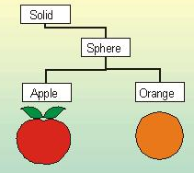
Learning a Class from Examples
ML model learns (enhances its experience) by looking at data instances (examples)
Examples: Let we want to learn a class ‘family car’
The data set consist of pictures of cars and each car is labeled as ‘family car’ and ‘not-family car’
Positive examples: cars labelled as family car
Negative examples: cars labelled as not-family car
‘Learning’ refers to finding the features/descriptions which are associated with family cars and filter out the features/descriptions which are associated with not-family cars
The Learning is also known as Knowledge Extraction

Slide 5
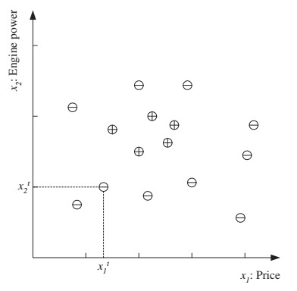
The Learning
Let we decide that the ‘family car’ class is learned based on two features
Input Features: Price and Engine Power, input features must be represented as numerical values
Model: The discriminator function we will build is known as class recognizer
In figure
Each data point corresponds one example car
‘+’ represents a positive example
‘-’ represents a negative example

Slide 6
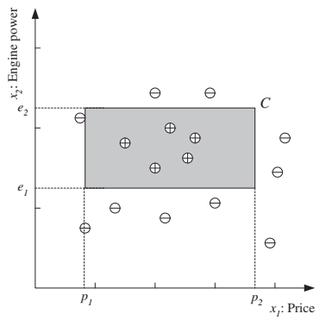
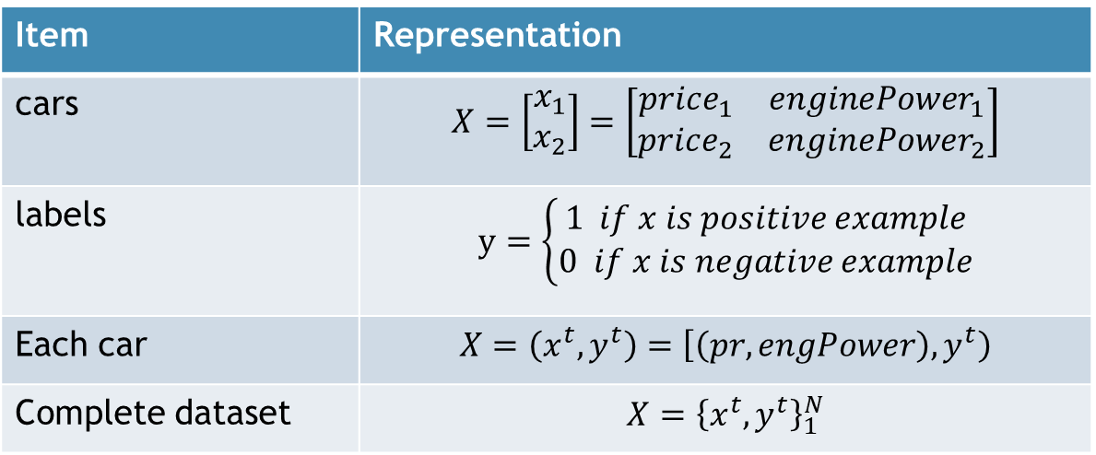
Model Representation
Item | Representation
cars | $$X=\left[\begin{matrix}x_{1} \\ x_{2}\end{matrix}\right]=\left[\begin{matrix}price_{1} & enginePower_{1} \\ price_{2} & enginePower_{2}\end{matrix}\right]$$
labels | $$y=\left\{\begin{aligned}1 if x is positive example \\ 0 if x is negative example\end{aligned}\right.$$
Each car | $$X=\left(x^{t},y^{t}\right)=\left[\left(pr,engPower\right),y^{t}\right)$$
Complete dataset | $$X={\left\{x^{t},y^{t}\right\}}_{1}^{N}$$
For a car to be a family car, its price and engine power should be in a certain range
$$\begin{aligned}familyCar=\left(e_{1}≤enginePower≤e_{2}\right) AND \left(p_{1}≤price≤p_{2}\right)\#(Eq. 1)\end{aligned}$$
The class of family car is a rectangle in the price-engine power space.

Slide 7
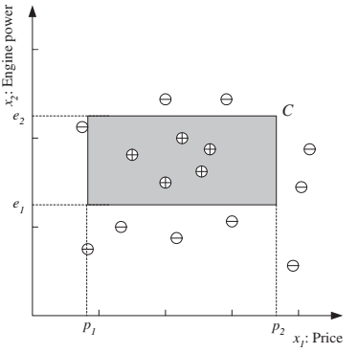

Hypothesis Class - H
$$\begin{aligned}familyCar=\left(e_{1}≤enginePower≤e_{2}\right) AND \left(p_{1}≤price≤p_{2}\right)\#(Eq.1)\end{aligned}$$
H is set of solutions from which we choose one.
Eq.1 fixes H from which C is drawn
The learning algorithm finds some $hεH$ specified by particular quadruple
$p_{1}^{h}, p_{2}^{h},e_{1}^{h},e_{2}^{h}$ to approximate C as closely as possible
Once $hεH$ is found, we can then estimate for given $x, h(x)$
$h\left(x\right)=\left\{\begin{aligned}1 if h classifies x as positive example \\ 0 if h classifies x as negative example\end{aligned}\right.$

Slide 8
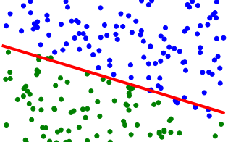
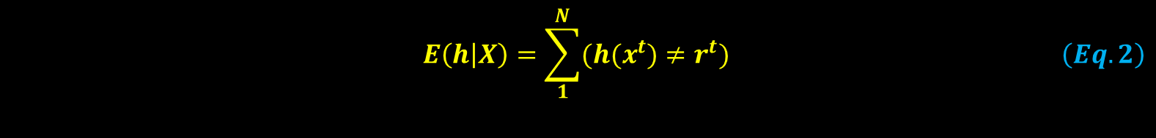

Empirical Error
Let $C(x)$is real solution. A classifier that exactly classifies the given instance of car
Let $h(x)$is estimate done on the bases of classifier experience
There is big number of family cars that $h(x)$ can not see
Hence has limited $h(x)$ has limited experience and $h(x)$ can not provide 100% correct classification for all car images
Empirical Error: it the proportion of the incorrect predictions made by $h(x)$ as compared to $C(x)$.
The error of hypothesis h given the training set X is
$$\begin{aligned}E\left(h | X\right)=\sum_{1}^{N}{(h(x^{t})≠r^{t})}\#\left(Eq.2\right)\end{aligned}$$

Slide 9
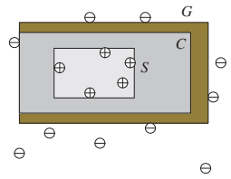

Hypothesis Generalization
Let $X_{1}={\left\{x^{t},r^{t}\right\}}_{1}^{N}$ be the training set
Let $X_{2}={\left\{x^{t},r^{t}\right\}}_{N}^{∞}$ be future examples set
$hεH$ is chosen hypothesis
How well $h$ hypothesis will correctly classify future examples$xεX_{2} and x∉X_{1}$
Most Specific Hypothesis (S): The tightest hypothesis (rectangle) that includes only positive examples.
Most General Hypothesis (G): the largest rectangle that we can draw which only includes the positive examples
Consistent hypothesis (C): Any hypothesis that lies between S and G.
Version Space (VS): Set of all hypothesis such that $VS=\left\{S≤h≤G\right\}$
Each dataset may have its own version space

Slide 10
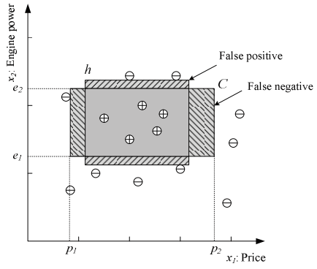

Confusion Matrix
Let $C$ is real solution
Let $h$ is learned solution
For a particular instance $x$
True positive ($TP):$If $C(x) = 1 and h(x)=1$
True Negative ($TN):$If $C(x) =0 and h(x)=0$
False positive ($FP):$ If $C(x) =0 and h(x)=1$
False Negative (FN$):$If $C(x) = 1 and h(x)=0$
h |  | C
 |  | 0 | 1
 | 0 | TN | FN
 | 1 | FP | TP
Confusion Matrix

Slide 11
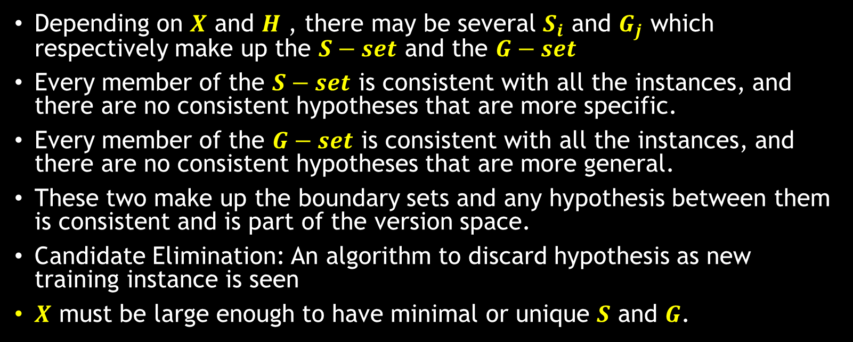
Data set and Hypothesis Set
Depending on $X$ and $H$ , there may be several $S_{i}$ and $G_{j}$ which respectively make up the $S−set$ and the $G−set$
Every member of the $S−set$ is consistent with all the instances, and there are no consistent hypotheses that are more specific.
Every member of the $G−set$ is consistent with all the instances, and there are no consistent hypotheses that are more general.
These two make up the boundary sets and any hypothesis between them is consistent and is part of the version space.
Candidate Elimination: An algorithm to discard hypothesis as new training instance is seen
$X$ must be large enough to have minimal or unique $S$ and $G$.

Slide 12
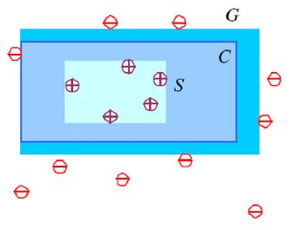


Boundary Margin of Hypothesis $h$
For each $hεH$ there is $S$ and $G$
Good practice is to chose h halfway between $S$ and $G$
Keep maximum margin between closest positive and negative examples
An error (loss) function checks two things
Whether our new instance is on right side of discriminator
How far it is from $S$
Instead of returning $0/1$, our new h will return $0/1$ along with loss
Doubt: If a prediction by h falls in boundary between $S$ and $G$
In such doubt case, system rejects the case and decision is referred to human expert

Slide 13
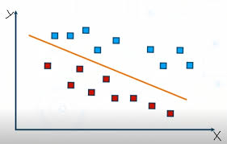
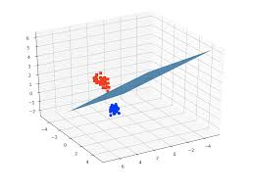

Learning Consistent Hypothesis
In previous discussion, we have assumed that $C$ is correctly learned
There may be the cases where $C$ is not properly learned
So before devising $h$, we need to make sure that our system can learn $C$
$H$ has enough capacity to learn $C$
Devised model should be capable to perform that task
You can not classify 3D data using 2D classifier

Slide 14
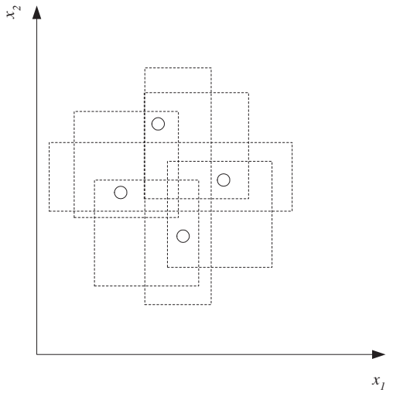

Vapnik-Chervonenkis Dimension
Let we have one car example to classify as ‘family’ or ‘not-family’
One example can be labelled in $2^{1}$ ways
$N$ examples can be labelled in $2^{N}$ ways
If $hεH$ classifies the positive and negative examples
We say that $H$ shatters(classifies) the $N$ examples
Vapnik-Chervonenkis Dimension (VC Dimension)
Maximum number of points that can be shattered (classified) by $H$
VC Dimension is also called the capacity of H
It is cardinality of largest set that can be shattered
An axis-aligned rectangle can shatter four points. Only rectangles covering two points are shown.

Slide 15
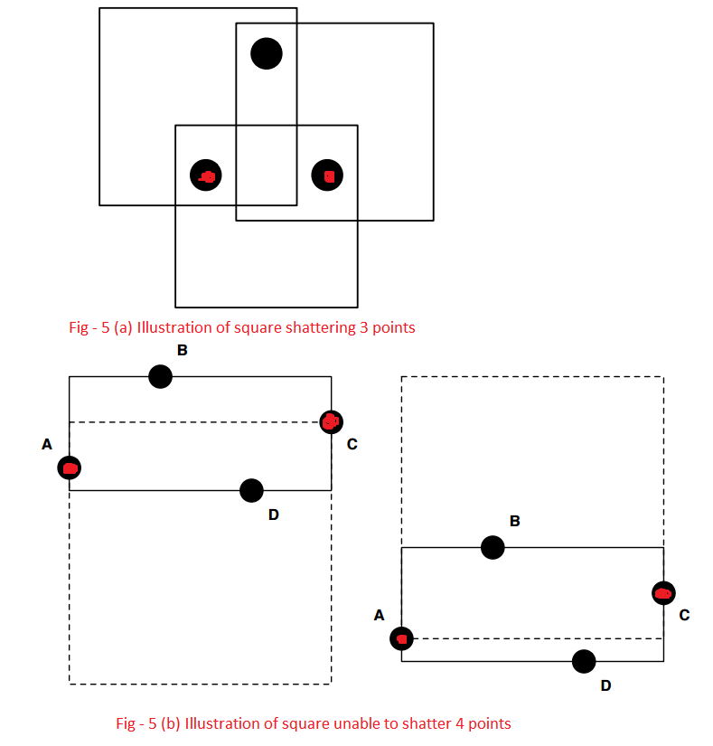
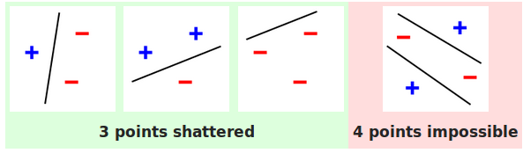
Power of Classifier
More power: Can model more complex classifiers but might overfit.
Less power: Not going to overfit, but restricted in what it can model.
The VC dimension is an estimate for the capability of a binary classifier
VC Dimension of a line

Slide 16
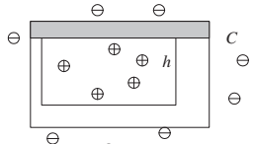

Probably Approximately Correct Learning
We can have absolutely correct hypothesis (rarely)
We can have approximately correct hypothesis (oftenly)
error probability be bounded by some value
We want to be confident in our hypothesis, hypothesis must be probably correct
Let for a given class C
Let $x_{i}$ (examples) are drawn from unknown fixed probability distribution $p(x)$
find the number of examples, N
hypothesis h has error at most $ε$
$P\left(C∆h≤ε\right)≥1−δ where δ≤\frac{1}{2} and ε>0$
$CΔh$ is the region of difference between C and h

Slide 17
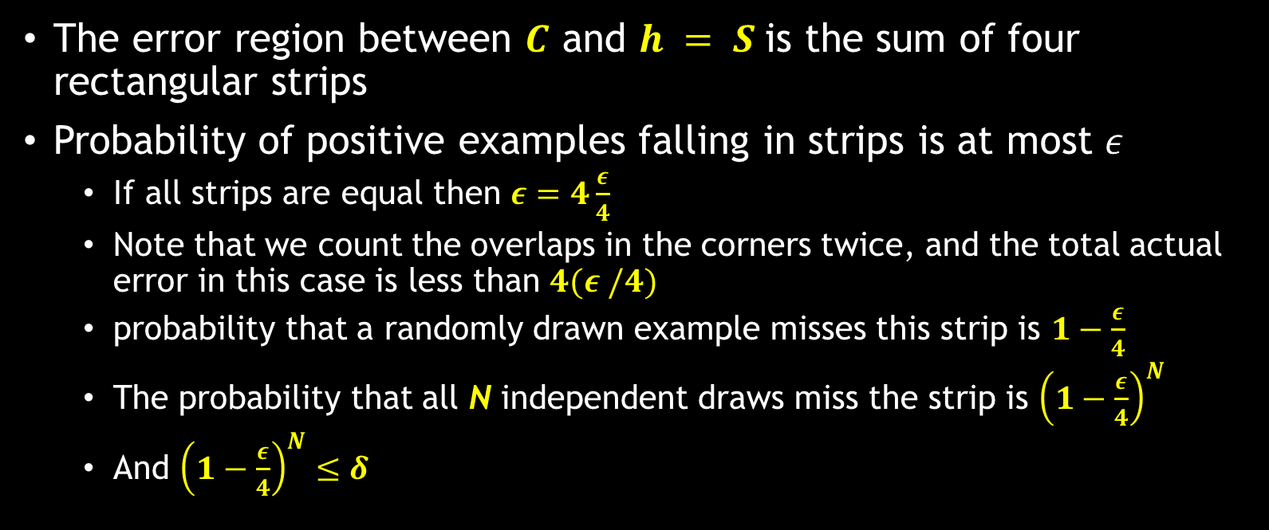
PAC Learning
The error region between $C$ and $h = S$is the sum of four rectangular strips
Probability of positive examples falling in strips is at most $ε$
If all strips are equal then $ε=4\frac{ε}{4}$
Note that we count the overlaps in the corners twice, and the total actual error in this case is less than $4(ε /4)$
probability that a randomly drawn example misses this strip is $1−\frac{ε}{4}$
The probability that all N independent draws miss the strip is ${\left(1−\frac{ε}{4}\right)}^{N}$
And ${\left(1−\frac{ε}{4}\right)}^{N}≤δ$

Slide 18

PAC Learning
We have the inequality $\left(1−x\right)≤e^{−x} and\log_{e}\left(1−x\right)≤−x$
$4{\left(1−\frac{ε}{4}\right)}^{N}≤ δ →4e^{\left[−\frac{εN}{4}\right]}≤δ$
$N≥(4/ε ) log⁡(4/δ)$
A given point will be misclassified with error probability at most $ε$
If we take at least $(4/ε ) log⁡(4/δ)$examples independent examples from C and use the tightest rectangle as our hypothesis h
With confidence probability at least $1 − δ$

Slide 19
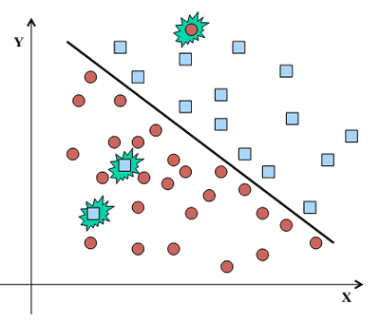
Noise
Any unwanted anomaly in the data is called noise
Noise can make the learning process difficult
zero error may be infeasible with a simple hypothesis class
The noise may be due to multiple reasons
Recording noise: imprecision in recording the input attributes
Teacher noise: errors in labeling the data points
Hidden or latent attributes: We may miss some important attributes to record

Slide 20
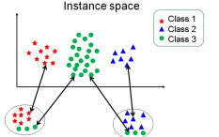

Learning Multiple Classes
Our car classification problem is binary class problem
There may be more than two classes in your dataset
Out training set is same as before $X_{1}={\left\{x^{t},r^{t}\right\}}_{1}^{N}$ and r has K dims.
$r_{i}^{t}=\left\{\begin{aligned}1 if x^{t} ε C_{i} \\ 0 if x^{t}ε C_{j} where j≠i\end{aligned}\right.$
In simple cases, learn the boundary separating the instances of one class from the instances of all other classes
The $x_{i}^{t}εC_{i}$are the positive instances of hypothesis $h_{i}$ and the examples of all other classes are the negative instances of $h_{i}$
Thus in a K-class problem, we have K hypotheses to learn such that
$h(x^{t})=\left\{\begin{aligned}1 if x^{t} ε C_{i} \\ 0 if x^{t}ε C_{j} where j≠i\end{aligned}\right.$

Slide 21
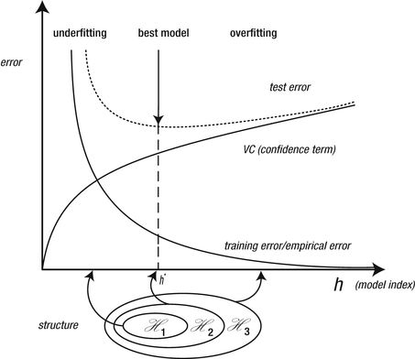

Total empirical error
$E\left({\left\{h_{i}\right\}}_{i=1}^{k} | X\right)=\sum_{t=1}^{N}{\sum_{i=1}^{k}{(h_{i}(x^{t})≠r_{i}^{t})}}$
For a given $x$, ideally only one of $h_{i}(x), i = 1, . . . , K$is 1 and we can choose a class
when no, or two or more, $h_{i}(x)$ is 1, we cannot choose a class, and this is the case of doubt and the classifier rejects such cases

Slide 22
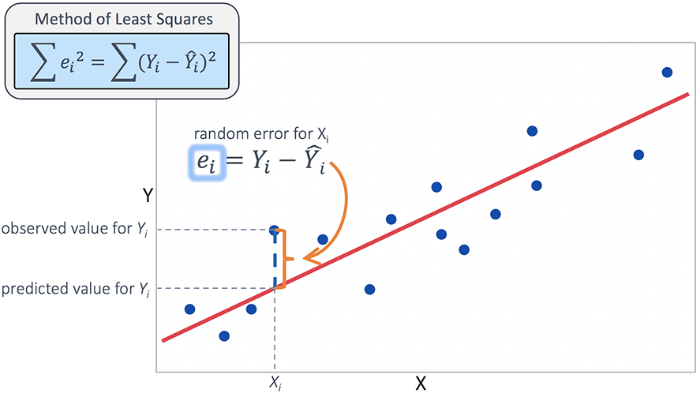
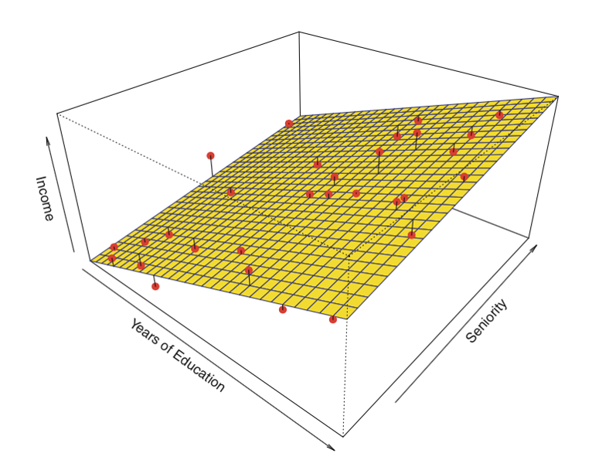

Regression
The output of a classification function is discrete i.e. class id
The output of a regression method is a numeric value
$X={\left\{x^{t},r^{t}\right\}}_{1}^{N} and r^{t} ε ℝ$
If there is no noise then the regression task is either interpolation or extrapolation $r^{t}=f\left(x^{t}\right)$
In case of noise, the estimation of function is
$r^{t}=f\left(x^{t}\right)+ε$
Empirical Error
$E\left(g | X\right)=\frac{1}{N}\sum_{t=1}^{N}{{\left[r^{t}−g\left(x^{t}\right)\right]}^{2}}$
This is mean squared error of training examples $loss=MSE$

Slide 23
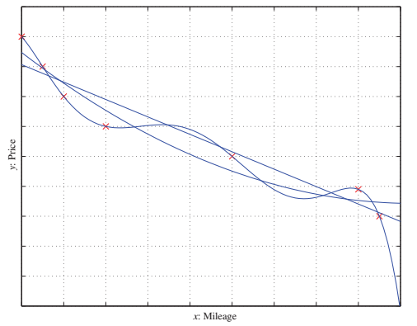
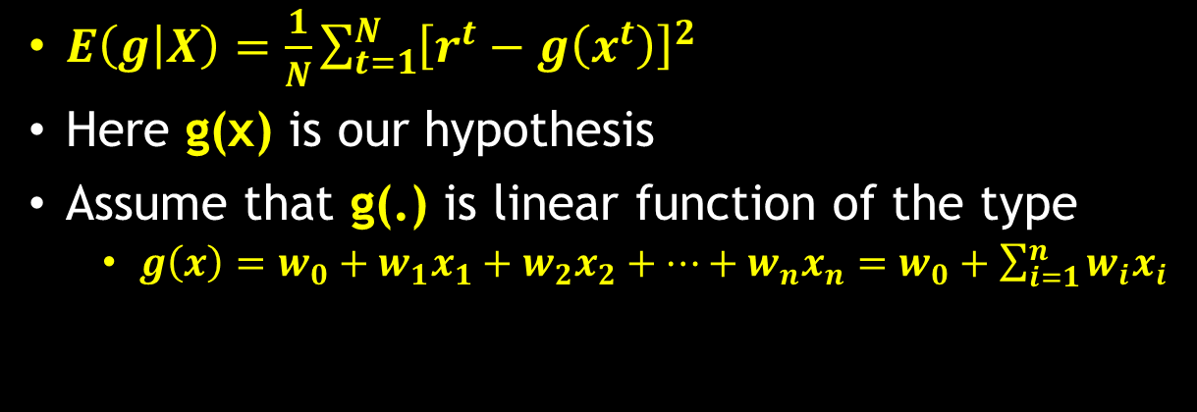
Regression
$E\left(g | X\right)=\frac{1}{N}\sum_{t=1}^{N}{{\left[r^{t}−g\left(x^{t}\right)\right]}^{2}}$
Here g(x) is our hypothesis
Assume that g(.) is linear function of the type
$g\left(x\right)=w_{0}+w_{1}x_{1}+w_{2}x_{2}+…+w_{n}x_{n}=w_{0}+\sum_{i=1}^{n}{w_{i}x_{i}}$
Linear, second-order, and sixth-order polynomials are fitted to the same set of points.
The highest order gives a perfect fit, but it overfits
The second order seems better than the linear fit in capturing the trend in the training data

Slide 24
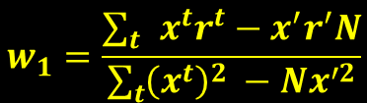
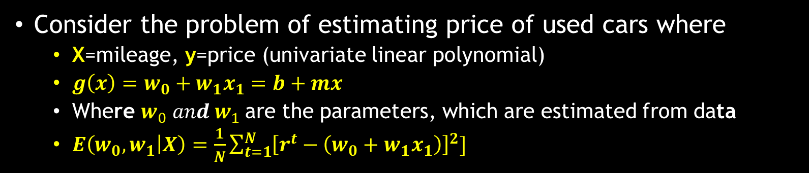



Regression
Consider the problem of estimating price of used cars where
X=mileage, y=price (univariate linear polynomial)
$g\left(x\right)=w_{0}+w_{1}x_{1}=b+mx$
Where $w_{0} and w_{1}$are the parameters, which are estimated from data
$E\left(w_{0},w_{1} | X\right)=\frac{1}{N}\sum_{t=1}^{N}{{\left[r^{t}−\left(w_{0}+w_{1}x_{1}\right)\right]}^{2}]}$
$$w_{1}=\frac{\sum_{t}{x^{t}r^{t}−x^{′}r^{′}N}}{\sum_{t}{{\left(x^{t}\right)}^{2} }−Nx^{′2}}$$
$$w_{0}=r^{′}−w_{1}x′$$
$$x′=\sum_{t}{x^{t}/N}$$
$$t′=\sum_{t}{r^{t}/N}$$

Slide 25
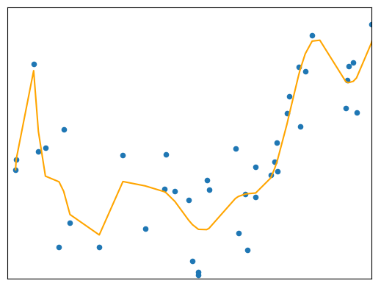
Regression
If the linear model is too simple, it is too constrained and incurs a large approximation error
When the order of the polynomial is increased, the error on the training data decreases.
But a high-order polynomial follows individual examples closely, instead of capturing the general trend;
This implies that Occam’s razor also applies in the case of regression

Slide 26
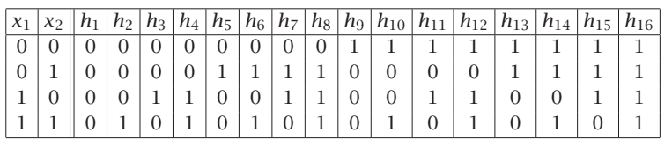

Model Selection and Generalization
In a Boolean function, all inputs and the output are binary
For d input data, the training set may have maximum $2^{d}$ examples
There may be $2^{d^{d}}$ possible Boolean functions for d-inputs
With 2 inputs, there are 4 possible cases and 16 possible Boolean functions

Slide 27

Ill posed problem
Each distinct training example removes half the hypotheses, whose guesses are wrong
Example: $x_{1} = 0, x_{2} = 1$and the output is $0$
To end up with a single hypothesis we need to see all $2^{d}$ training examples
For small amount of training examples, the solutions are multiple
After seeing N example cases, there remain $2^{2^{d}}−N$ possible functions
ill-posed problem where the data by itself is not sufficient to find a unique solution

Slide 28
Inductive BIAS
The learning is ill-posed
Data by itself is not sufficient to find the solution
We should make some extra assumptions to have a unique solution with the data we have
Inductive BIAS: The set of assumptions we make inductive bias to have learning possible
there are infinitely many ways of separating the positive examples from the negative examples
Examples
The shape of a rectangle is one inductive bias
The rectangle with the largest margin is another inductive bias
In linear regression, assuming a linear function is an inductive bias
choosing the one that minimizes squared error is another inductive bias

Slide 29
Extending the capacity of hypothesis
To extend the capacity of hypothesis, two or more hypothesis can be combined resulting in complex hypothesis
Learning is not possible without inductive bias
Model Selection:
How to choose inductive bias
How to chose H – The hypothesis class

Slide 30
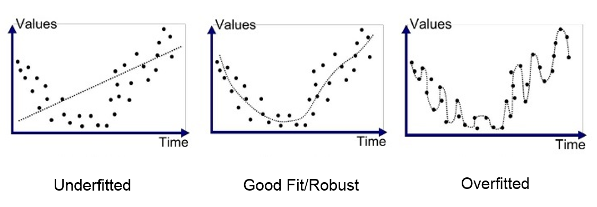
Model Generalization
Generalization: How well a model trained on the training set predicts the right output for new generalization instances
For best generalization, match the complexity of the hypothesis class H with the complexity of the function underlying the data
Underfitting: If H is less complex than the function
More training data can reduce this effect
Overfitting: If H is more complex than the function,
More training data can help or not

Slide 31
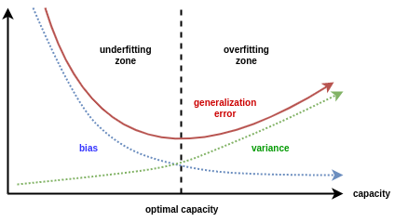
Triple Trade Off
All learning algorithms have trade off between three factors
The capacity of the hypothesis class
As the complexity of the model class H increases, the generalization error decreases first and then starts to increase.
The amount of training data
As the amount of training data increases, the generalization error decreases
The generalization error on new examples
The generalization error of an overcomplex H can be kept in check by increasing the amount of training data but only up to a point.

Slide 32
Measurement of Generalization
Generalization ability of a hypothesis can be measured through data which is not used in training
Normally available dataset is divided into two parts
Training data
Validation data
used to test the generalization ability
Cross Validation
Train different hypothesis and the hypothesis that is the most accurate on the validation set is the best one
Test data/publication set:
This data is used in production environment usually
contains examples not used in training or validation
80% | 20%
Train Split | Validation Split
$$h1$$
$$h2$$
$$h3$$
$$h4$$
$$h5$$
 | 1-20 | 21-40 | 41-60 | 61-80 | 81-100

Slide 33
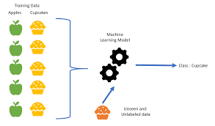

Dimensions of a Supervised Machine Learning Algorithm
independent and identically distributed (iid) examples $X={\left\{x^{t},r^{t}\right\}}_{1}^{N}$
the ordering is not important and all instances are drawn from the same joint distribution $p(x,r)$
For binary class: $r^{t} ε \{0,1\}$
For multi-classes: each $r^{t}$ is k-value vector where exactly one value is 1
For 3 classes : $r^{t} ε \{100,010,100\}$
This representation is called one-hot encoding
The aim is to build a good and useful approximation to $r^{t}$ using model $g(x^{t}|θ)$

Slide 34
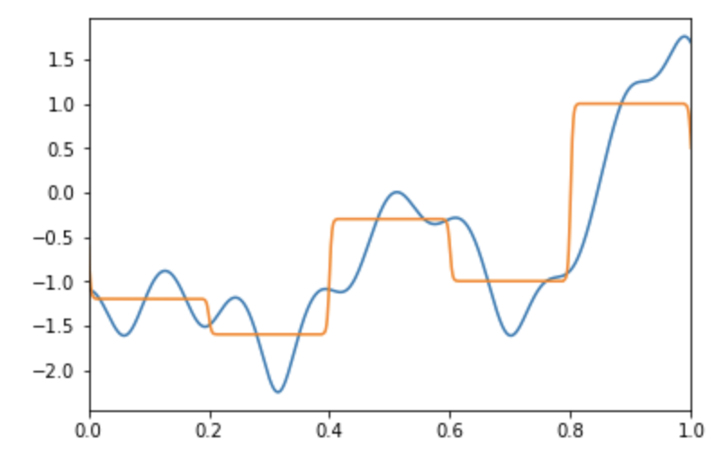

Building a good approximation
Selection of model(inductive Bias): $g\left(x | θ\right)$
$θ$ helps to find best $hεH$
Loss function: L(.)
to compute the difference between the desired output$(r^{t})$, and approximation to it given by $g\left(x | θ\right)$
approximation error, or loss: $E\left(θ | X\right)=\sum_{t}{L(r^{t}, g(x|θ))}$
Optimization procedure:
to find $θ^{∗}$ that minimizes the total error $θ^{∗}=arg min_{θ}{E(θ|X)}$
Different machine learning algorithms differ either
in the models they assume (their hypothesis class/inductive bias)
the loss measures they employ
the optimization procedure they use

Slide 35



Thanks for watching
Dr. Sajid Iqbal
Assistant Professor
Department of Computer Science
Bahauddin Zakariya University, Multan
sajidiqbal.pk@gmail.com
https://github.com/sajjo79/Design_and_Analysis_of_Algorithms
Allah Hafiz
COMEDXD

Slide 36
Theoretical Assignments
Solve all the exercises of the chapter

Slide 37

Programming Exercises
Write a program in python that takes values for following parameters
$enginePower_{1}, enginePower_{2}, price_{1}, price_{2}$
Define the criteria for two classes (family car, not family car)
Based on read parameters, decide the class of car.
Draw the graph using python matplotlib library
Write a program to find the VC dimension of given data points
Write a program to perform regression for uni-variable data. Do not use any builtin API

